Slide 1

Matoshri College of Engineering and Research Centre, Nashik
Department of Computer Engineering
Academic Year 2024 - 25
PHASE – I INTERNAL PRESENTATION
Project Title : AI powered mock interview platform
Guide Name : Ms. P. R. Dholi
Presented By : Shivam Mangesh Patil
Kapil Vikas Shinde Sandesh Sanjay Dunbale
Bhavesh Ganesh Vakare

Slide 2

Index
Introduction
Literature Survey
Motivation
Problem Statement
Objective
Architecture diagram
Mathematical Model
Modules
Description of each module
Design of System (Sequence & State transition)
Implementation details of first module
Project Plan
Conclusion
References

Slide 3

Introduction to topic
The AI-based Mock Interview system is an innovative platform designed to help individuals prepare for real-world job interviews by simulating the entire interview process. By leveraging artificial intelligence, the system offers a personalized and immersive experience where users can practice key aspects of interviews, including self-introduction, technical knowledge, and aptitude testing. With an easy-to-navigate interface, users can register, upload their resumes, and participate in multiple interview stages tailored to their professional background. The system provides comprehensive feedback and performance analysis, helping users refine their skills and boost confidence before facing actual interviews. This platform serves as a valuable tool for job seekers aiming to improve their interview performance and secure employment opportunities.

Slide 4
Literature Survey
Sr.no | Title | Author | Published | Year | Technology | Limitation
1 | AI-Driven Mock Interview Systems: A Review | A. S. Kumar and P. R. Sharma | Journal of Artificial Intelligence Research | 2022 | Machine Learning, Natural Language Processing | Limited datasets for training; may not cover niche industries effectively.
2 | Improving Job Interview Preparedness with Virtual Simulations | M. J. Thompson and L. S. Wong | International Journal of Human- Computer Interaction | 2023 | Virtual Reality, AI Simulation | High setup costs; requires specialized hardware for immersive experiences.

Slide 5
Sr.n o | Title | Author | Published | Year | Technology | Limitation
3 | The Role of AI in Career Development: Mock Interviews as a Tool | R. K. Patel and T. L. Johnson | IEEE Transactions on Learning Technologies | 2024 | AI Algorithms, Feedback Mechanisms | May lack real- time adaptability to user responses; dependency on predefined question sets.
4 | Using Conversational Agents for Interview Preparation | S. P. Lee and H. Y. Kim | Journal of Computer Science and Technology | 2022 | Chatbots, NLP | Can struggle with understanding complex user queries; may provide generic feedback.

Slide 6

Motivation
The motivation behind the AI-based Mock Interview system stems from the increasing competition in the job market, where candidates must not only possess the right qualifications but also excel in interview performance. Many job seekers face anxiety and uncertainty when preparing for interviews, often lacking access to practical resources and real-time feedback. By leveraging artificial intelligence, this system offers a personalized and immersive platform that allows users to practice critical interview skills in a safe environment

Slide 7
Problem Statement
In today's competitive job market, many candidates struggle with interview preparation, leading to anxiety and suboptimal performance during actual interviews. Traditional preparation methods often lack personalized feedback and do not simulate the real interview experience, leaving job seekers unprepared and uncertain. Additionally, candidates from diverse backgrounds may not have access to tailored resources that address their specific needs and challenges.

Slide 8
Objective
Develop a Personalized Mock Interview Platform: Create an AI-based system that tailors interview simulations to individual users based on their professional background and job roles.
Enhance Interview Skills: Provide practice across key areas, including self-introduction, technical knowledge, and behavioral questions, to improve overall performance.
Offer Real-Time Feedback: Implement a feedback mechanism that analyzes user responses and provides constructive insights for improvement.
Boost User Confidence: Design an immersive and interactive experience that helps users build confidence and reduce anxiety before actual interviews.

Slide 9

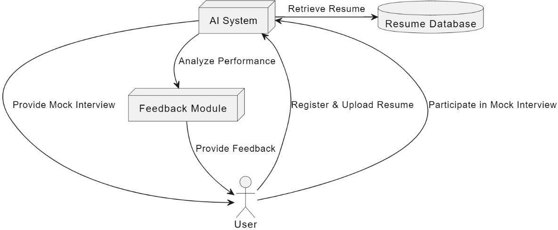
System Architecture

Slide 10
Mathematical Model
System Description :
S = (I,O,F)
Where,
S: System.
I = { MT, UL,VU} are set of Inputs Where,
MT : Mock Test
UL : User Login
VU: Video Upload

Slide 11
F = {A, DP, PM}are set of Function
Where,
A : Authentication DP: Data Processing. PM: Prediction Module
O = { CR} are set of Output Where,
CR: Carrier Recommendation
Success Conditions :
Proper database.
Failure Conditions :
No database, Internet connection

Slide 12
Details of Modules
User Registration Module
Purpose: Allows candidates to create accounts
and upload resumes.
Features:
User authentication (login/signup)
Resume upload functionality
Profile setup and information input
Resume Parsing Module
Purpose: Extracts relevant information from uploaded resumes to create user profiles.
Features:
Automated parsing of key details
(education, work experience, skills)
Data storage in a structured format for later use
Algorithms : - K-Nearest Neigbor(KNN)

Slide 13
Modules cont…
Question Generation Module
Purpose: Generates tailored interview questions based on
the user’s profile.
Features:
Algorithm for creating questions based on industry standards Customization based on user experience level and job role Algorithms : - Cosine Similarity Algorithm
Interview Simulation Module
Purpose: Provides a realistic mock interview environment.
Features:
Interactive interface for answering questions
Timer functionality to simulate real interview conditions Algorithms : - Natural Language Processing(NLP),RAG model

Slide 14
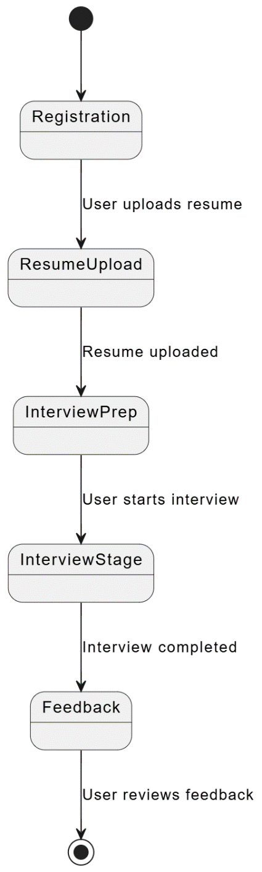
State Transition Diagram

Slide 15
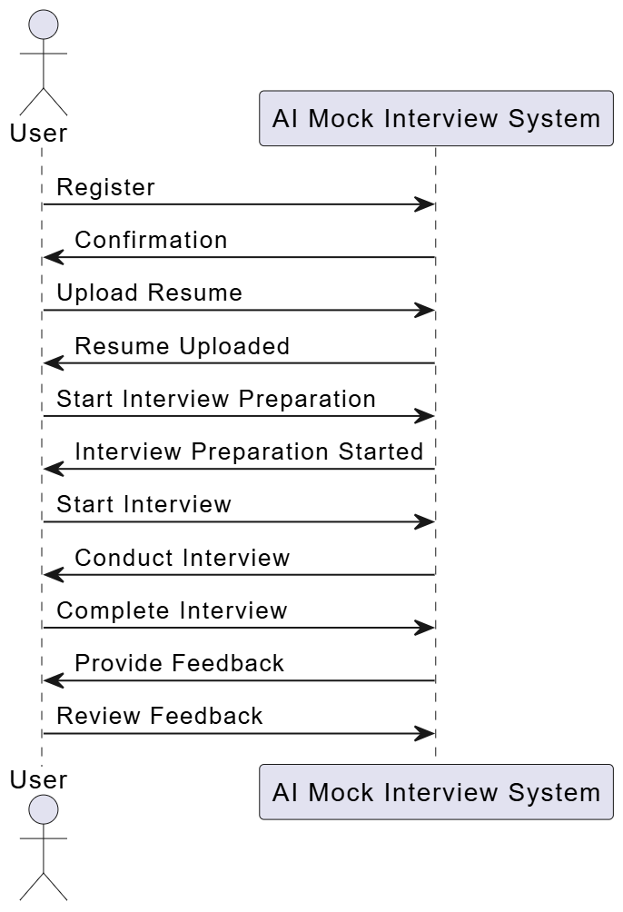
Sequence Diagram

Slide 16
Implementation Details of project
User Registration: Create a user-friendly interface for candidates to register and
upload their resumes.
Profile Analysis: Parse the uploaded resume to extract relevant information and generate a user profile.
Question Generation: Develop an algorithm to generate tailored interview questions based on the user’s background and job preferences.
Interview Simulation: Implement a mock interview environment where users
can respond to the generated questions.
Response Collection: Capture and record user responses during the interview simulation.
Performance Evaluation: Analyze the collected responses to assess performance
using predefined metrics.
Feedback Generation: Provide detailed feedback and performance analysis to the user, including areas for improvement.
Confidence Assessment: Evaluate the user's confidence level based on their responses and delivery.
Progress Tracking: Implement a feature to track user progress over multiple
sessions and provide ongoing insights.

Slide 17
Conclusion
In conclusion, the AI-based Mock Interview system represents a significant advancement in interview preparation, offering a comprehensive, user-friendly platform that addresses the challenges faced by job seekers today. By providing a realistic simulation of the interview process, personalized feedback, and detailed performance analysis, this system empowers users to enhance their skills and confidence effectively. As the job market continues to evolve, the need for accessible and adaptive training tools becomes increasingly critical. This innovative solution not only prepares candidates for success in interviews but also contributes to their overall professional development, ultimately bridging the gap between academic knowledge and real-world application. By investing in their preparation through this platform, users are better equipped to navigate the complexities of job interviews and secure their desired positions.

Slide 18
References
Hossain, M. N., & Nisa, A. A. (2023). Artificial Intelligence in Recruitment: Impact on Efficiency and Decision Making. Journal of Human Resource Management, 11(2), 75-90.
Cascio, W. F., & Montealegre, R. (2022). How Technology is Reshaping Work and Workplaces: The Role of AI in Recruitment. Personnel Psychology, 75(1), 1-22.
Yeo, R. K., & Goh, K. J. (2023). The Ethical Challenges of AI in Recruitment: Balancing Efficiency and Fairness. Human Resource Management Review, 33(2), 100832.
Singh, A., & Kumar, S. (2024). The Future of AI in Talent Acquisition: Trends and Challenges. International Journal of Human Resource Management, 35(1), 134-150.
Berrios, J. D., & Lee, Y. S. (2024). Transforming Talent Acquisition: The Role of AI Technologies. Journal of Business Research, 157, 1-11.

Slide 19
Thank You

